Slide 1
Image Enhancement
(Spatial Domain)
Last updated: 13-11-15
$ Szeliski R., Computer Vision - Algorithms and Applications, Springer, 2011. (Ch. 3)
Gonzalez R. C., Woods R. E., Eddins S. L., Digital Image Processing Using Matlab, Pearson Education, 2nd edition, 2009. (Ch. 3)
# Gonzalez R. C., Woods R. E., Eddins S. L., Digital Image Processing, Pearson Education, 3rd edition, 2007. (Ch. 3)
Notes:
www.csie.ntnu.edu.tw/~violet/IP93/Chapter03.ppt

Slide 2
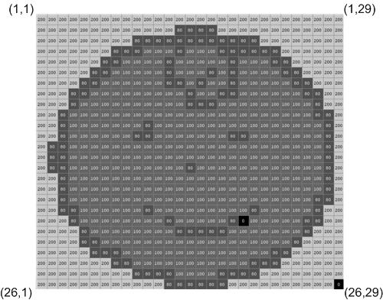
Background
Notes:
http://www.cs.uregina.ca/Links/class-info/425/Lab2/

Slide 3
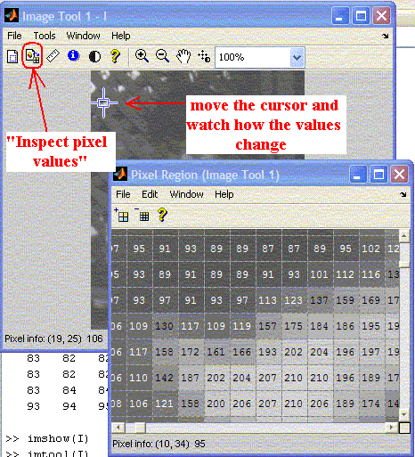
Background
>> f = imread('rose.tif');
>> imtool(f)
Notes:
http://www.cs.uregina.ca/Links/class-info/425/Lab2/

Slide 4
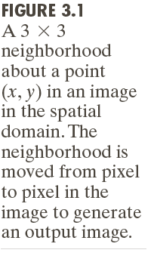
Background
g(x, y) = T[f(x, y)] => s = T(r)

Slide 5
Intensity Transformation Functions
Image Negative
Power-Law
Logarithmic
Contrast Stretching

Slide 6
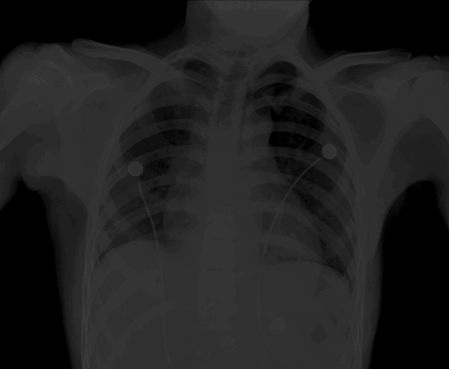
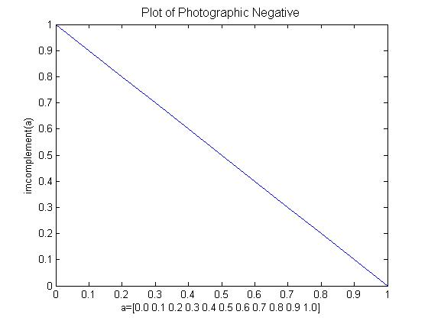
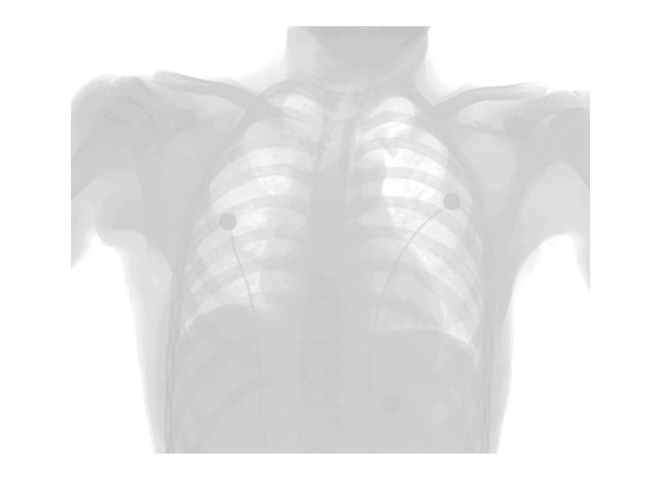
Image Negative
Digital negatives are often produced if the region of interest contains mostly darker pixels (low intensity values)
s = (L – 1) – r, where r ∈ [0, L-1]
>> g = imcomplement(f);
Notes:
http://www.cs.uregina.ca/Links/class-info/425/Lab2/

Slide 7
Power-Law (Gamma) Transformations
Useful for brightening the darkest regions (0 < γ < 1) or darkening the brightest regions in an image (γ > 1).
Here L = 2.

Slide 8
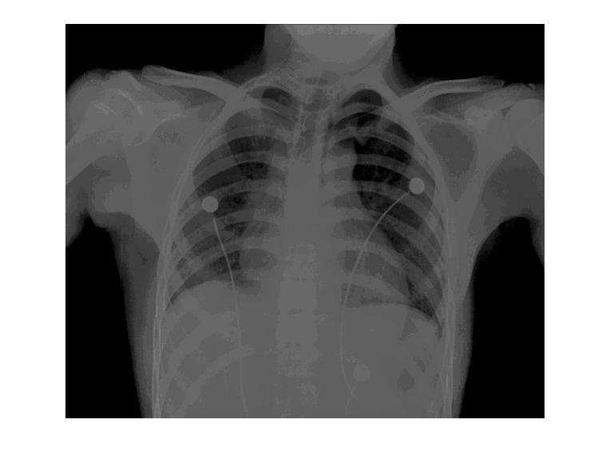
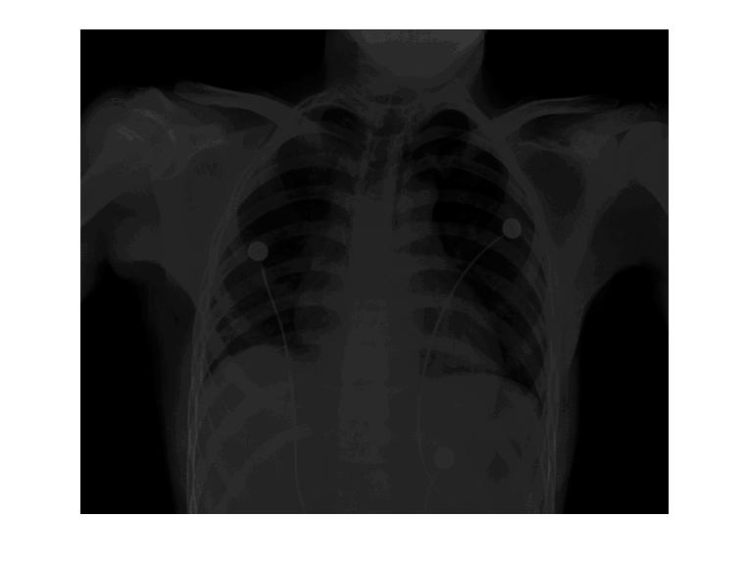
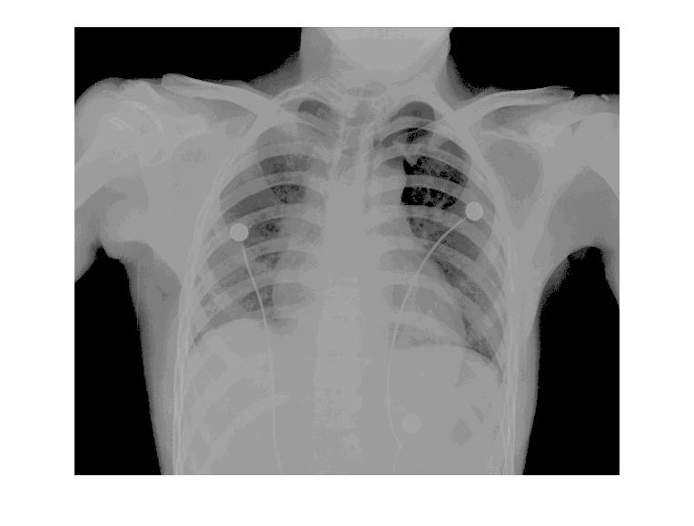

Power-Law (Gamma) Transformations
g = imadjust(f, [low_in high_in], [low_out high_out], gamma);
Example:
a. >> f = imread('xray.tif');
b. >> g = imadjust(f, [0 0.5], [0 1]);
c. >> g = imadjust(f, [0 0.5], [0 1], 2);
d. >> g = imadjust(f, [0 0.5], [0 1], 0.5);
e. >> g = imadjust(f, [ ], [ ], 0.5);
f. >> g = imadjust(f, [0 1], [1 0]);
a
b
c
Can we have negative image by using imadjust()?
d
e
f
Notes:
Or Gamma transformations

Slide 9
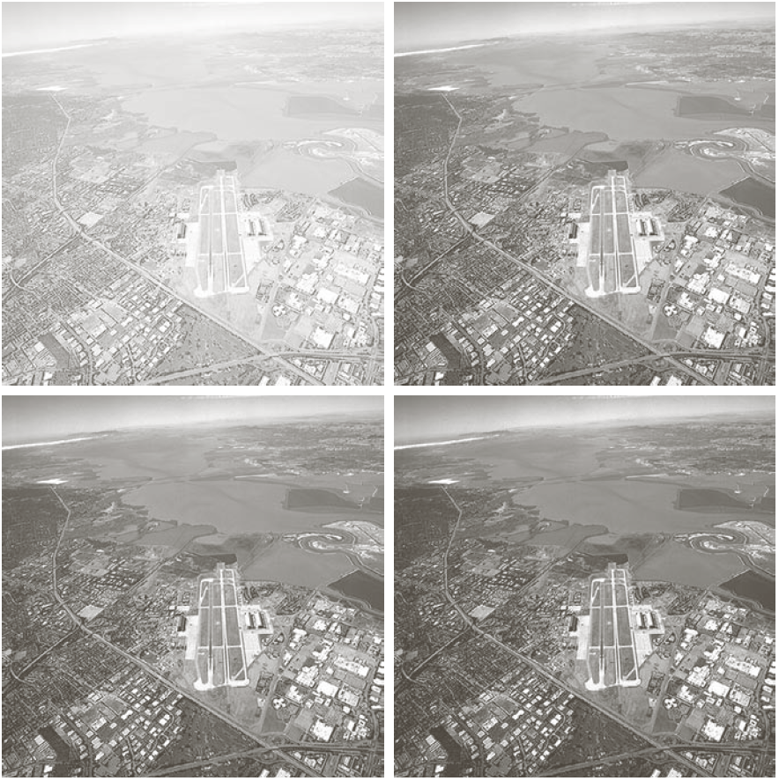
Power-Law (Gamma) Transformations
Notes:
Or Gamma transformations

Slide 10
Power-Law (Gamma) Transformations
>> rgb = imread('baby-mom.tif');
>> hsv = rgb2hsv(rgb);
>> hsv1 = hsv(:, :, 1);
>> hsv2 = hsv(:, :, 2);
>> hsv3 = hsv(:, :, 3);
>> hsv3a = imadjust(hsv3);
>> hsvNew = cat(3, hsv1, hsv2, hsv3a);
>> rgbNew = hsv2rgb(hsvNew);
>> imshow(rgb), figure, imshow(rgbNew)

Slide 11
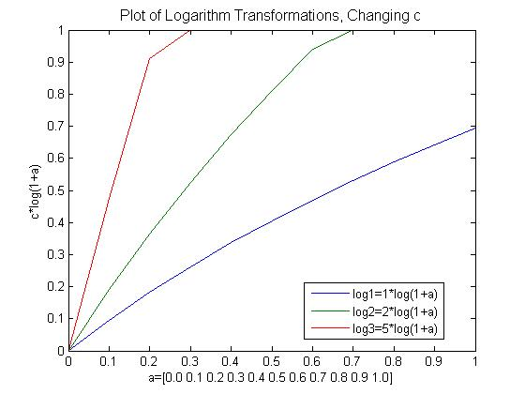
Logarithmic Transformations

Slide 12
Logarithmic Transformations
Used to compress the dynamic range of values within an image.
s = c * log(1 + double(r))
where c is constant
>> f = [0.1 2; 3000 900000];
1.0e+005 *
0.0000 0.0000
0.0300 9.0000
>> h = mat2gray(f)
h =
0 0.0000
0.0033 1.0000
>> g = log(1+double(f))
g =
0.0953 1.0986
8.0067 13.7102
>> h = mat2gray(g)
h =
0 0.0737
0.5811 1.0000

Slide 13
Logarithmic Transformations
>> f = imread('spectrum.tif');
>> g = im2uint8(mat2gray(log(1+double(f))));
>> imshow(g)

Slide 14
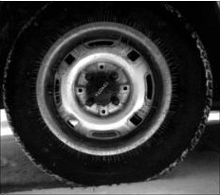
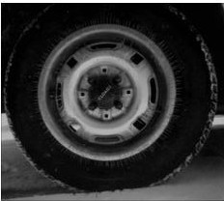
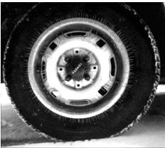
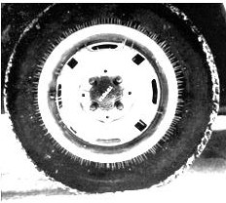
Logarithmic Transformations
I=imread('tire.tif'); imshow(I) I2=im2double(I); J=1*log(1+I2); J2=2*log(1+I2); J3=5*log(1+I2); figure, imshow(J) figure, imshow(J2) figure, imshow(J3)
Original c =1
c = 2 c =5
Notes:
http://www.cs.uregina.ca/Links/class-info/425/Lab3/lesson.html

Slide 15
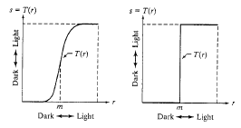
Contrast-Stretching Transformations
Used to compress the dynamic range of values within an image.
s = T(r) = 1 / (1 + (m/r)^{E}),
where 0 < m < r
Output values are scaled to the range [0, 1]
>> g = 1./(1 + (m./(double(f) + eps)).^E)
E = 20
E -> 

Slide 16
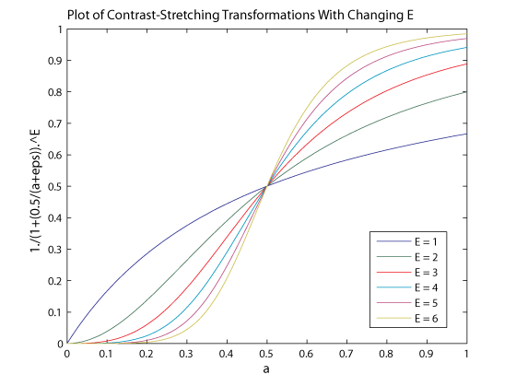
Contrast-Stretching Transformations

Slide 17
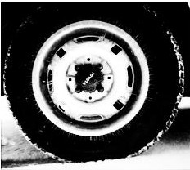
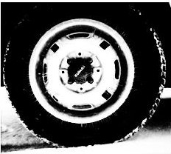
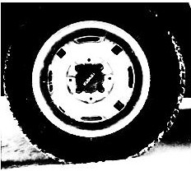
Contrast-Stretching Transformations
I=imread('tire.tif'); I2=im2double(I);
m=mean2(I2) contrast1=1./(1+(m./(I2+eps)).^4); contrast2=1./(1+(m./(I2+eps)).^5); contrast3=1./(1+(m./(I2+eps)).^10); imshow(I2) figure,imshow(contrast1) figure,imshow(contrast2) figure,imshow(contrast3)
Original E =4
E = 5 E =10
Notes:
http://www.cs.uregina.ca/Links/class-info/425/Lab3/lesson.html

Slide 18
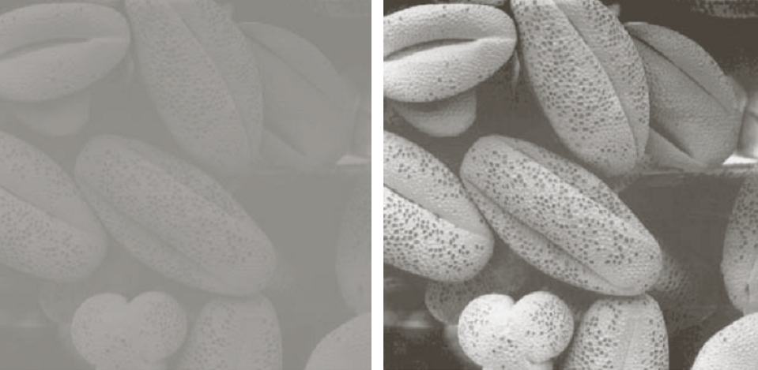
Contrast-Stretching Transformations: Exercise
Original Transformed
MatLab Code ?

Slide 19
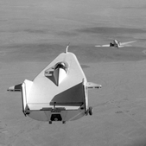
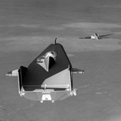
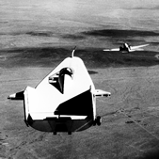
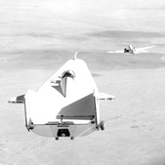
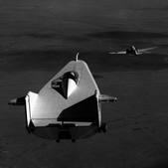
Intensity Transformations: Exercise
Identify which intensity transformation was used on MATLAB's built-in liftingbody.png to create each of the four results below. Write a script to reproduce the results using the intensity transformation functions.
Original
Result 1 Result 2 Result 3 Result 4
Notes:
http://www.cs.uregina.ca/Links/class-info/425/Lab3/index.html

Slide 20
Bit-Plane Slicing
Digitally, an image is represented in terms of pixels. These pixels can be expressed further in terms of bits. Consider the image ‘coins.png’ and the pixel representation of the image.
Notes:
http://angeljohnsy.blogspot.com/2012/11/bit-plane-slicing.html

Slide 21
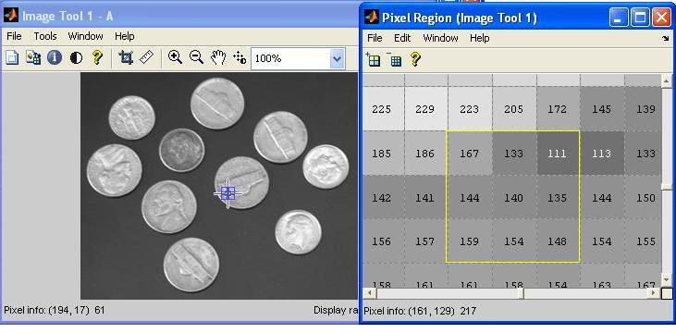
Bit-Plane Slicing
Consider the pixels that are bounded within the yellow line. The binary formats for those values are (8-bit representation)

Slide 22
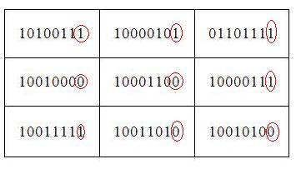
Bit-Plane Slicing
The binary format for the pixel value 167 is 10100111
Similarly, for 144 it is 10010000
This 8-bit image is composed of eight 1-bit planes.
Plane 1 contains the lowest order bit of all the pixels in the image.

Slide 23
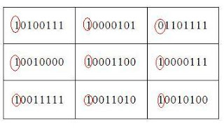
Bit-Plane Slicing
And plane 8 contains the highest order bit of all the pixels in the image.

Slide 24
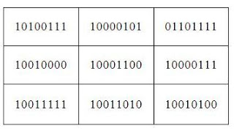
Combining Bit Planes
The nth plane in the pixels are multiplied by the constant 2^n-1
For instance, consider the matrix
A=[ 167 133 111
144 140 135
159 154 148] and the respective bit format
Combine the 8 bit plane and 7 bit plane.
For 10100111, multiply the 8 bit plane with 128 and 7 bit plane with 64.
(1x128)+(0x64)+(1x0)+(0x0)+(0x0)+(1x0)+(1x0)+(1x0)=128
Repeat this process for all the values in the matrix and the final result will be
[ 128 128 64
128 128 128
128 128 128 ]

Slide 25
Bit-Plane Slicing in Matlab
A=[167 133 111
144 140 135
159 154 148];
B=bitget(A,1) %Lowest order bit of all pixels
B =
1 1 1
0 0 1
1 0 0
>> B=bitget(A,8) %Highest order bit of all pixels
B =
1 1 0
1 1 1
1 1 1

Slide 26
Bit-Plane Slicing in Matlab
A=[167 133 111
144 140 135
159 154 148];
B=bitget(A,1) %Lowest order bit of all pixels
B =
1 1 1
0 0 1
1 0 0
>> B=bitget(A,8) %Highest order bit of all pixels
B =
1 1 0
1 1 1
1 1 1

Slide 27
Bit-Plane Slicing in Matlab: Example
>> A=imread('coins.png');
>> B=bitget(A,1);
>> imshow(logical(B)); title('Bit plane 1');
>> B=bitget(A,2);
>> imshow(logical(B)); title('Bit plane 2');
>> B=bitget(A,3);
>> imshow(logical(B)); title('Bit plane 3');
>> B=bitget(A,4);
>> imshow(logical(B));title('Bit plane 4');

Slide 28
Bit-Plane Slicing in Matlab: Example
>> B=bitget(A,5);
>> imshow(logical(B)); title('Bit plane 5');
>> B=bitget(A,6);
>> imshow(logical(B)); title('Bit plane 6');
>> B=bitget(A,7);
>> imshow(logical(B)); title('Bit plane 7');
>> B=bitget(A,8);
>> imshow(logical(B));title('Bit plane 8');
0-127 -> 0 128-255 -> 1

Slide 29
Bit-Plane Slicing in Matlab: Example
%Image reconstruction by combining 8 bit plane and 7 bit plane
>> B=zeros(size(A));
>> B=bitset(B,7,bitget(A,7));
>> B=bitset(B,8,bitget(A,8));
>> B=uint8(B);
>> imshow(B);
Notes:
‘bitset’ is used to set a bit at a specified position. Use ‘bitget’ to get the bit at the positions 7 and 8 from all the pixels in matrix A and use ‘bitset’ to set these bit values at the positions 7 and 8 in the matrix B.

Slide 30
Bit-Plane Slicing in Matlab: Example
%Image reconstruction by combining 8,7,6 and 5 bit planes
>> B=zeros(size(A));
>> B=bitset(B,8,bitget(A,8));
>> B=bitset(B,7,bitget(A,7));
>> B=bitset(B,6,bitget(A,6));
>> B=bitset(B,5,bitget(A,5));
>> B=uint8(B);
>> imshow(B);

Slide 31
Histogram Processing & Function Plotting
Generating & Plotting Image Histograms:
h(r_{k}) = n_{k}
where r_{k} is the k^{th} intensity value,
n_{k} is the number of pixels in the image with
intensity r_{k}.
Normalized Histogram:
p(r_{k}) = h(r_{k})/n
= n_{k}/n, (Relative frequency)
where n = MxN, the size of image
>> imhist(f);

Slide 32
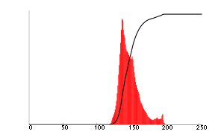

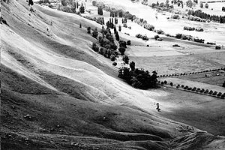
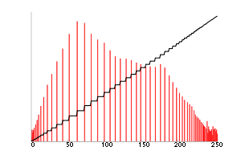
Histogram Equalization
Histogram equalization attempts to obtain an even distribution of intensity values in the image, often resulting in increased contrast.
An unequalized image
Histogram (red)
Cumulative histogram (black)
The same image after histogram equalization
Notes:
https://en.wikipedia.org/wiki/Histogram_equalization

Slide 33

# Histogram Equalization
The intensity levels in an image may be viewed as random variables in the interval [0, L-1].
Let P_{r}(r) and P_{s}(s) denote the probability density function (PDF) of random variables r and s, resp.
(3.3-4)

Slide 34
# Histogram Equalization
At first, the continuous case will be studied:
r is the intensity of the image in [0, L-1].
we focus on transformations s=T(r):
T(r) is strictly monotonically increasing.
T(r) must satisfy:

Slide 35
# Histogram Equalization
The condition for T(r) to be monotonically increasing guarantees that ordering of the output intensity values will follow the ordering of the input intensity values (avoids reversal of intensities).
If T(r) is strictly monotonically increasing then the mapping from s back to r will be 1-1.
The second condition (T(r) in [0,1]) guarantees that the range of the output can be the same as the range of the input.

Slide 36
# Histogram Equalization
Let the transformation s = T(r) satisfies the following conditions:
(a) T(r) is single-valued and monotonically increasing in the interval 0 ≤ r ≤ 1. We cannot perform inverse mapping (from s to r).
(b) 0 ≤ T(r) ≤ 1 for 0 ≤ r ≤ 1. Inverse mapping is possible.

Slide 37
# Histogram Equalization
Let p_{r}(r) & p_{s}(s) denote the probability density functions (PDF) of random variables r & s, respectively.
Let the transformation:
We can view intensities r and s as random variables and their histograms as PDFs p_{r}(r) and p_{s}(s).
The PDF of the output levels is uniform, i.e., the above transformation generates an image whose intensity levels are equally likely and cover the entire range [0, 1].
For discrete quantities we work with summations, and the above transformation becomes:
for k = 1, 2, …, L.

Slide 38
Histogram Equalization
Given histogram of image (gray-level values & their numbers)
Step 1: Normalize the number of gray-levels values by dividing by the total number of pixels.
Step 2: Create a running sum (cumulative) of the histogram values.
Step 3: Multiply these values by the maximum gray-level value and then round the result to the closest integer.
Step 4: Map the original values to the results from step 3 by a one-to-one correspondence.

Slide 39
Histogram Equalization
Example: Consider a 55 image with 3 bits/pixel:
Gray-level value | Number of pixels | Step 1 | Step 2 | Step 3 | Step 4
r | h(r) | Normalized h(r) | Cumulative ch(r) | ch(r) x 7 | s(r)
0 | 5 | 5/25 | 5/25 | 1 | 0
1 | 8 | 8/25 | 13/25 | 4 | 5
2 | 1 | 1/25 | 14/25 | 4 | 0
3 | 2 | 2/25 | 16/25 | 4 | 0
4 | 3 | 3/25 | 19/25 | 5 | 11
5 | 2 | 2/25 | 21/25 | 6 | 3
6 | 1 | 1/25 | 22/25 | 6 | 3
7 | 3 | 3/25 | 25/25 | 7 | 3
Total | 25 | 1 |  |  | 25
1 | 1 | 3 | 3 | 2
1 | 1 | 0 | 0 | 1
4 | 0 | 7 | 6 | 0
1 | 4 | 7 | 7 | 0
1 | 4 | 5 | 5 | 1
4 | 4 | 4 | 4 | 4
4 | 4 | 1 | 1 | 4
5 | 1 | 7 | 6 | 1
4 | 5 | 7 | 7 | 1
4 | 5 | 6 | 6 | 4

Slide 40
Histogram Equalization
Exercise: Consider the histogram equalized image of previous example:
and apply again the process of histogram equalization. Do you notice any change?
4 | 4 | 4 | 4 | 4
4 | 4 | 1 | 1 | 4
5 | 1 | 7 | 6 | 1
4 | 5 | 7 | 7 | 1
4 | 5 | 6 | 6 | 4

Slide 41
Histogram Equalization
Example: Given the frequency distribution (instead of image):
Gray-level value | Number of pixels | Step 1 | Step 2 | Step 3 | Step 4
r | h(r) | Normalized h(r) | Cumulative ch(r) | ch(r) x 7 | s(r)
0 | 19 | 19/100 | 19/100 | 1 | 0
1 | 25 | 25/100 | 44/100 | 3 | 19
2 | 16 | 16/100 | 60/100 | 4 | 0
3 | 13 | 13/100 | 73/100 | 5 | 25
4 | 10 | 10/100 | 83/100 | 6 | 16
5 | 7 | 7/100 | 90/100 | 6 | 13
6 | 6 | 6/100 | 96/100 | 7 | 17
7 | 4 | 4/100 | 100/100 | 7 | 10
Total | 100 | 1 |  |  | 100
Notes:
Step 4 is obtained by counting the corresponding number of gray-levels from r in Step 3

Slide 42
Histogram Equalization
Example: Given the frequency distribution (instead of image):
Gray-level value | Number of pixels
r | h(r)
0 | 19
1 | 25
2 | 16
3 | 13
4 | 10
5 | 7
6 | 6
7 | 4
ORIGINAL HISTOGRAM
25
20
15
10
5
0
0 1 2 3 4 5 6 7

Slide 43
Histogram Equalization
Example: Given the frequency distribution (instead of image):
Gray-level value | Step 4
r | s(r)
0 | 0
1 | 19
2 | 0
3 | 25
4 | 16
5 | 13
6 | 17
7 | 10
TRANSFORMED HISTOGRAM
25
20
15
10
5
0
0 1 2 3 4 5 6 7

Slide 44
Histogram Equalization - Summary
After histogram equalization, the intensity values are more effectively distributed over the histogram range.
Contrast is increased.
Repeated histogram equalization does not change image.
If the pixel p is the brightest pixel in range x, it will remain the brightest pixel.
Frequencies of gray-levels in histogram equalized image are not exactly same due to the discrete values and round off.
# If the transformation is monotone increasing, grey level order of the image is preserved, such that for any two grey levels t₁ and t₂ , and their corresponding transformed values T[t₁] and T[t₂]:
t₁ < t₂ if and only if T[t₁] < T[t₂]

Slide 45
Histogram Equalization in Matlab
>> f = imread('pollen.tif');
>> h = histeq(f);
>> subplot(2,2,1), imshow(f), subplot(2,2,2), histogram(f), subplot(2,2,3), imshow(h), subplot(2,2,4), histogram(h)

Slide 46
#Histogram Matching or Specification
Histogram matching is similar to histogram equalization, except that instead of trying to make the output image have a flat histogram, we would like it to have a histogram of a specified shape, say p_{z}(z).
Notes:
http://fourier.eng.hmc.edu/e161/lectures/contrast_transform/node3.html

Slide 47
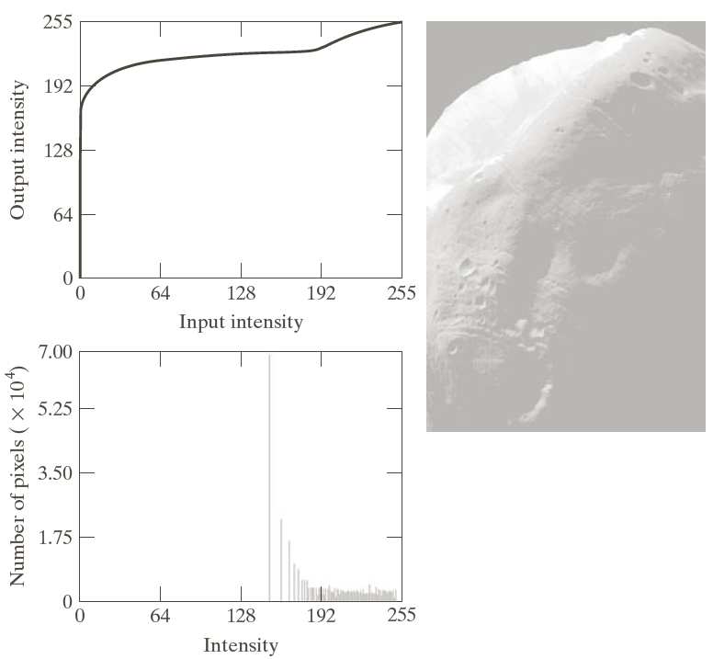
#Histogram Matching or Specification
Notes:
Not included in undergraduate course

Slide 48
#@Histogram Matching or Specification
1. We obtain p_{r}(r) from the input image and use
to obtain intensity values s.
2. Use the specified PDF in
to obtain the transformed function G(z).
3. We can find z = G⁻¹(s) whose PDF is equal to the specified PDF p_{z}(z).
Note: w is dummy variable of integration
Notes:
Further add from Chapter_03b_Intensity_Transformations_(Histogram_Processing).ppt in temp folder

Slide 49
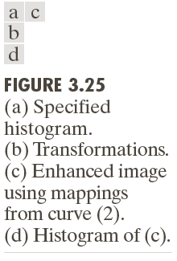
#@Histogram Matching or Specification
Equalize the initial histogram of the image:
Equalize the target histogram:
which is labelled (1) in Figure 3.25 (b),
for a value of q so that G(z_{q}) = s_{k} = T(r_{k})
where the inverse transformation is
which is labelled (2) in Figure 3.25 (b).

Slide 50
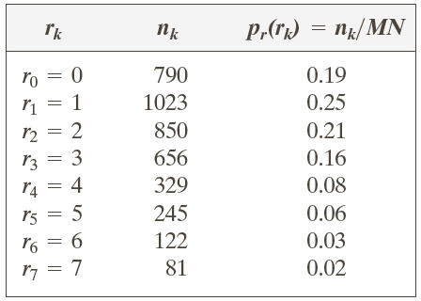
#@Histogram Matching or Specification
Consider the 3-bit 64x64 image:
It is desired to transform this histogram to:
with

Slide 51
#@Histogram Matching or Specification
First we will equalize both input and output (as before):
Notice that G(z) is not strictly monotonic. We must resolve this ambiguity by choosing, e.g., the smallest value for the inverse mapping.
r | p_{r}(r_{k}) | Cumulative ch(r) | s_{k}=ch(r)x7
0 | 0.19 | 0.19 | 1
1 | 0.25 | 0.44 | 3
2 | 0.21 | 0.65 | 5
3 | 0.16 | 0.81 | 6
4 | 0.08 | 0.89 | 6
5 | 0.06 | 0.95 | 7
6 | 0.03 | 0.98 | 7
7 | 0.02 | 1 | 7
z | p_{z}(z_{k}) | Cumulative ch(z) | G(z_{q})=ch(z)x7
0 | 0 | 0 | 0
1 | 0 | 0 | 0
2 | 0 | 0 | 0
3 | 0.15 | 0.15 | 1
4 | 0.2 | 0.35 | 2
5 | 0.3 | 0.65 | 5
6 | 0.2 | 0.85 | 6
7 | 0.15 | 1 | 7

Slide 52
#@Histogram Matching or Specification
Perform inverse mapping: For every value of s_{k} find the smallest value of G(z_{q}) that is closest to s_{k}: and store these mappings from s_{k} to z_{q}.
every pixel with value s₀=1 in the histogram-equalized image would have a value of 3 (z₃) in the histogram-specified image

Slide 53
#@Histogram Matching or Specification
r | p_{r}(r_{k}) | s_{k} | G(z_{q}) | Mapping of s_{k} & G(z_{q}) | p_{z}(z_{q}) (result) | p_{z}(z_{q}) (desired)
0 | 0.19 | 1 | 0 | 3 | 0 | 0
1 | 0.25 | 3 | 0 | 4 | 0 | 0
2 | 0.21 | 5 | 0 | 5 | 0 | 0
3 | 0.16 | 6 | 1 | 6 | 0.19 | 0.15
4 | 0.08 | 6 | 2 | 6 | 0.25 | 0.2
5 | 0.06 | 7 | 5 | 7 | 0.21 | 0.3
6 | 0.03 | 7 | 6 | 7 | 0.24 | 0.2
7 | 0.02 | 7 | 7 | 7 | 0.11 | 0.15

Slide 54
#@Histogram Matching or Specification
Notice that due to discretization, the resulting histogram will rarely be exactly the same as the desired histogram.

Slide 55
#@Histogram Matching or Specification
A Specified Histogram
function p = twomodegauss(m1, sig1, m2, sig2, A1, A2, k)
% Generates a two-mode Gaussian function. in the interval [0,1].
% P is a 256-element vector normalized so that SUM(P) equals 1.
% The mean and standard deviation of the modes are (M1, SIG1) and (M2, SIG2), resp.
% A1 and A2 are the amplitude values of the two modes.
% Since the output is normalized, only the relative values of A1 and A2 are important.
% K is an offset value that raises the "floor" of the function.
c1 = A1 * (1 / ((2 * pi) ^ 0.5) * sig1);
k1 = 2 * (sig1 ^ 2);
c2 = A2 * (1 / ((2 * pi) ^ 0.5) * sig2);
k2 = 2 * (sig2 ^ 2);
z = linspace(0, 1, 256);
p = k + c1 * exp(-((z - m1) .^ 2) ./ k1) + ...
c2 * exp(-((z - m2) .^ 2) ./ k2);
p = p ./ sum(p(:));

Slide 56
#@Histogram Matching or Specification
Example
>> f = imread('Mars-Moon.tif');
>> imshow(f);
>> imhist(f);
>> g = histeq(f, 256);
>> imshow(g);
>> imhist(g);
% desired histogram
>> p = twomodegauss(0.15, 0.05, 0.75, 0.05, 1, 0.07, 0.002);
>> h = histeq(f, p);
>> plot(p);

Slide 57
#@Histogram Matching or Specification
Example
>> imshow(g);
>> imhist(h);

Slide 58
#@Histogram Matching or Specification
Algorithm
INPUT: Input image, Target image
OUTPUT: Output image that has the same characteristic as the target image
Steps:
Read the Input image and the Target image.
Obtain the histogram of the input image and the target image.
Equalize the input and the target images.
Calculate the transformation function of the target Image.
Map the original image gray level to the final gray level.
Notes:
http://www.cse.iitm.ac.in/~vplab/courses/CV_DIP/PDF/HIST_PROC.pdf

Slide 59
#Local or Adaptive Histogram Processing
It is the process of small regions of the image (called tiles) using histogram equalization for each tile individually.

Slide 60
#Local or Adaptive Histogram Processing
>> imshow(f);
>> g1 = adapthisteq(f); % default is 'NumTiles', [8 8]
>> imshow(g1)
>> g2 = adapthisteq(f, 'NumTiles', [25 25]);
>> imshow(g2)
% 'ClipLimit‘: Real scalar in the range [0 1] that specifies a contrast enhancement limit. Higher numbers result in more contrast. Default: 0.01
>> g3 = adapthisteq(f, 'NumTiles', [25 25], 'Cliplimit', 0.05);
>> imshow(g3)

Slide 61
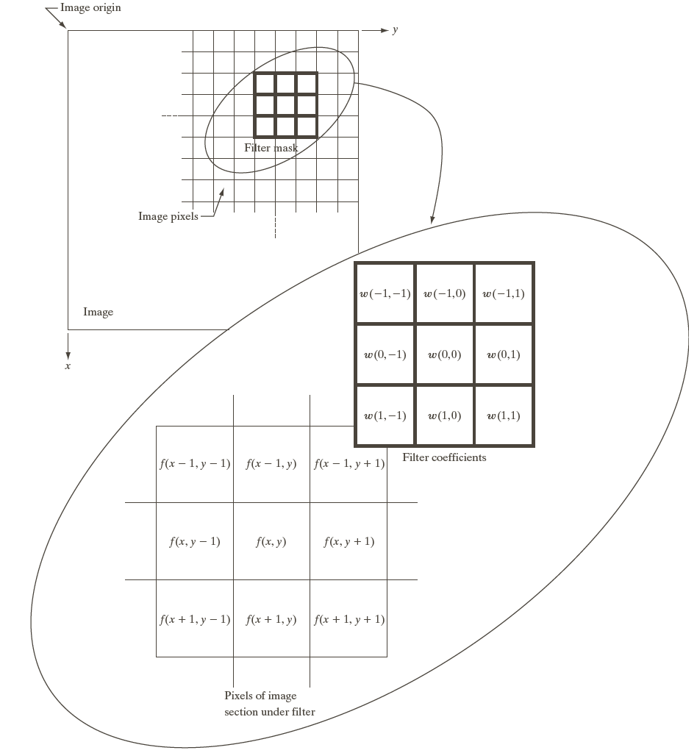
Spatial Filtering (Neighborhood Processing)
Linear Spatial Filtering
@ Nonlinear Spatial Filtering
Mask Size: m  n
We assume: m = 2a+1, n = 2b+1
where a and b are non-negative integers

Slide 62
Spatial Filtering (Neighborhood Processing)
Linear Spatial Filtering
f₁ f₂ f₃
f₄ f₅ f₆
f₇ f₈ f₉
w₁ w₂ w₃
w₄ w₅ w₆
w₇ w₈ w₉
g₅ = f₁*w₁+ f₂*w₂+ f₃*w₃+ f₄*w₄+ f₅*w₅+ f₆*w₆+ f₇*w₇+ f₈*w₈+ f₉*w₉

Slide 63
Spatial Filtering (Neighborhood Processing)
Linear Spatial Filtering
0 -1 0
-1 4 -1
0 -1 0
2 3 5 7 2
3 4 7 5 2
5 6 5 3 1
2 6 2 2 1
7 3 3 2 0

Slide 64
Spatial Filtering (Neighborhood Processing)
Linear Spatial Filtering
0 -1 0
-1 4 -1
0 -1 0
2 3 5 7 2
3 4 7 5 2
5 6 5 3 1
2 6 2 2 1
7 3 3 2 0

Slide 65
Spatial Filtering (Neighborhood Processing)
Linear Spatial Filtering
0 -1 0
-1 4 -1
0 -1 0
2 3 5 7 2
3 4 7 5 2
5 6 5 3 1
2 6 2 2 1
7 3 3 2 0
2

Slide 66
Spatial Filtering (Neighborhood Processing)
Linear Spatial Filtering
0 -1 0
-1 4 -1
0 -1 0
2 3 5 7 2
3 4 7 5 2
5 6 5 3 1
2 6 2 2 1
7 3 3 2 0
2
1

Slide 67
Spatial Filtering (Neighborhood Processing)
Linear Spatial Filtering
0 -1 0
-1 4 -1
0 -1 0
2 3 5 7 2
3 4 7 5 2
5 6 5 3 1
2 6 2 2 1
7 3 3 2 0
2 1
3

Slide 68
Spatial Filtering (Neighborhood Processing)
Linear Spatial Filtering
0 -1 0
-1 4 -1
0 -1 0
2 3 5 7 2
3 4 7 5 2
5 6 5 3 1
2 6 2 2 1
7 3 3 2 0
2 1 3
16

Slide 69
Spatial Filtering (Neighborhood Processing)
Linear Spatial Filtering
0 -1 0
-1 4 -1
0 -1 0
2 3 5 7 2
3 4 7 5 2
5 6 5 3 1
2 6 2 2 1
7 3 3 2 0
2 1 3 16
-1

Slide 70
Spatial Filtering (Neighborhood Processing)
Linear Spatial Filtering
0 -1 0
-1 4 -1
0 -1 0
2 3 5 7 2
3 4 7 5 2
5 6 5 3 1
2 6 2 2 1
7 3 3 2 0
2 1 3 16 -1
1

Slide 71
Spatial Filtering (Neighborhood Processing)
Linear Spatial Filtering
0 -1 0
-1 4 -1
0 -1 0
2 3 5 7 2
3 4 7 5 2
5 6 5 3 1
2 6 2 2 1
7 3 3 2 0
2 1 3 16 -1
1
-3

Slide 72
Basics of Spatial Filtering
In spatial filtering (vs. frequency domain filtering), the output image is computed directly by simple calculations on the pixels of the input image.
Spatial filtering can be either linear or non-linear.
For each output pixel, some neighborhood of input pixels is used in the computation.
In general, linear filtering of an image f of size MN with a filter mask of size mn is given by
where a=(m-1)/2 and b=(n-1)/2
This concept is called convolution. Filter masks are sometimes called convolution masks or convolution kernels.

Slide 73
Basics of Spatial Filtering
Nonlinear spatial filtering usually uses a neighborhood too, but some other mathematical operations are used. These can include conditional operations (if …, then …), statistical (sorting pixel values in the neighborhood, mean, median), etc.
Because the neighborhood includes pixels on all sides of the center pixel, some special procedure must be used along the top, bottom, left and right sides of the image so that the processing does not try to use pixels that do not exist.

Slide 74
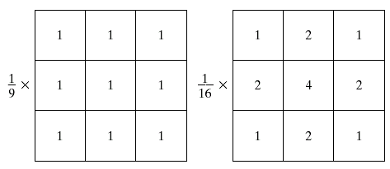
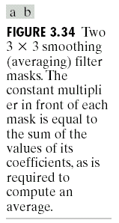
Smoothing Spatial Filters
Smoothing linear filters
Averaging filters (Lowpass filters in Chapter 4))
Box filter
Weighted average filter
Box filter
Weighted average

Slide 75
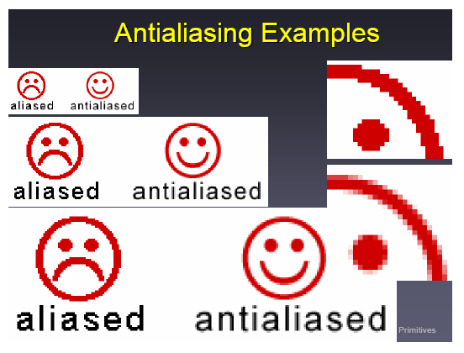
Smoothing Spatial Filters
Which mask is suitable for anti-aliasing?
Box filter
Weighted average

Slide 76
Smoothing Spatial Filters
The general implementation for filtering an M  N image with a weighted averaging filter of size m  n is given by
where a=(m-1)/2 and b=(n-1)/2
Weighted average

Slide 77
Spatial Filtering (Neighborhood Processing)
Linear Spatial Filtering
Given a filter w and an image f, we can compute a filtered image g such that g(x,y) is a linear combination of f(x,y) and its neighbors.

Slide 78
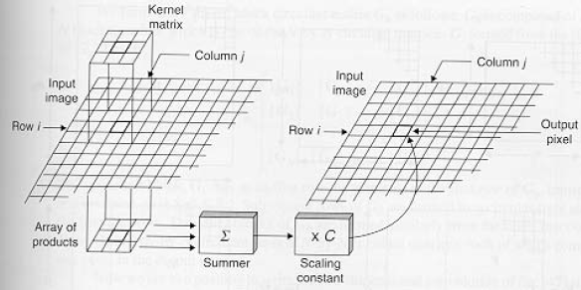
Spatial Filtering (Neighborhood Processing)
Linear Spatial Filtering
Correlation
Convolution
Padding
Same or Full
w(i,j)
f(i,j)

Slide 79
Spatial Filtering (Neighborhood Processing)
Given an image f and mask w:
Correlation
f =
0 0 0 0 0
0 0 0 0 0
0 0 1 0 0
0 0 0 0 0
0 0 0 0 0
w =
1 4 7
2 5 8
3 6 9
w1 =
9 8 7
6 5 4
3 2 1
g =
9 6 3
8 5 2
7 4 1
g1 =
1 2 3
4 5 6
7 8 9
Convolution
Solution
Another solution: Keep mask symmetric

Slide 80
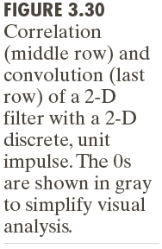
Spatial Filtering (Neighborhood Processing)
Correlation & Convolution with Zero Padding

Slide 81
Spatial Filtering (Neighborhood Processing)
Linear Spatial Filtering: Syntax
g = imfilter(f, w, filtering_mode, boundary_options, size_options)
filtering_mode: 'corr' (default) or 'conv'
boundary_options: (Input array values outside the bounds of the array)
P Implicitly assumed to have the value P. (Default is P = 0).
'symmetric' Computed by mirror-reflecting the array across the array border.
'replicate' Assumed to equal the nearest array border value.
'circular' Computed by implicitly assuming the input array is periodic.
size_options 'same' (default) or 'full'

Slide 82
Spatial Filtering (Neighborhood Processing)
Linear Spatial Filtering
>> fp=padarray(f, [2 2], 0)
fp =
0 0 0 0 0 0 0 0 0
0 0 0 0 0 0 0 0 0
0 0 1 0 0 0 0 0 0
0 0 0 2 0 0 0 0 0
0 0 0 0 3 0 0 0 0
0 0 0 0 0 4 0 0 0
0 0 0 0 0 0 5 0 0
0 0 0 0 0 0 0 0 0
0 0 0 0 0 0 0 0 0
>> gp = imfilter(fp, w)
gp =
0 0 0 0 0 0 0 0 0
0 -1 -1 -1 0 0 0 0 0
0 -1 6 -3 -2 0 0 0 0
0 -1 -3 12 -5 -3 0 0 0
0 0 -2 -5 18 -7 -4 0 0
0 0 0 -3 -7 24 -9 -5 0
0 0 0 0 -4 -9 36 -5 0
0 0 0 0 0 -5 -5 -5 0
0 0 0 0 0 0 0 0 0
>> f=[1 0 0 0 0; 0 2 0 0 0; 0 0 3 0 0; 0 0 0 4 0; 0 0 0 0 5]
f =
1 0 0 0 0
0 2 0 0 0
0 0 3 0 0
0 0 0 4 0
0 0 0 0 5
>> w=[-1 -1 -1; -1 8 -1; -1 -1 -1]
w =
-1 -1 -1
-1 8 -1
-1 -1 -1
>> g = imfilter(f, w)
g =
6 -3 -2 0 0
-3 12 -5 -3 0
-2 -5 18 -7 -4
0 -3 -7 24 -9
0 0 -4 -9 36

Slide 83
Spatial Filtering (Neighborhood Processing)
Linear Spatial Filtering – Padding Options
>> f=[1 2; 3 4]
f =
1 2
3 4
>> fp=padarray(f, [2 2], 0)
fp =
0 0 0 0 0 0
0 0 0 0 0 0
0 0 1 2 0 0
0 0 3 4 0 0
0 0 0 0 0 0
0 0 0 0 0 0
>> fp=padarray(f, [2 2], 'symmetric')
fp =
4 3 3 4 4 3
2 1 1 2 2 1
2 1 1 2 2 1
4 3 3 4 4 3
4 3 3 4 4 3
2 1 1 2 2 1
>> fp=padarray(f, [2 2], 'replicate')
fp =
1 1 1 2 2 2
1 1 1 2 2 2
1 1 1 2 2 2
3 3 3 4 4 4
3 3 3 4 4 4
3 3 3 4 4 4
>> fp=padarray(f, [2 2], 'circular')
fp =
1 2 1 2 1 2
3 4 3 4 3 4
1 2 1 2 1 2
3 4 3 4 3 4
1 2 1 2 1 2
3 4 3 4 3 4

Slide 84


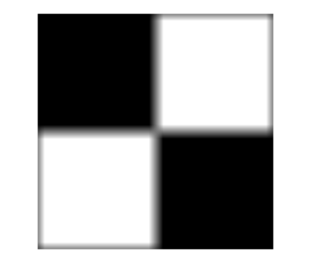
Spatial Filtering (Neighborhood Processing)
Linear Spatial Filtering:
>> f = imread('boxes.tif');
>> class(f)
ans =
uint8
>> w = ones(31);
>> g = imfilter(f, w);
>> imshow(f), figure, imshow(g, [ ]) Why?
>> fd = im2double(f);
>> gd = imfilter(fd, w);
>> imshow(fd), figure, imshow(gd, [ ])

Slide 85
Spatial Filtering (Neighborhood Processing)
Linear Spatial Filtering
Exercise 1a: Explain the following
Why image boxes.tif is not blurred around the outside boundary of black boxes?
Why corners of black boxes don’t join when we use uint8 data type of image?
1b: Consider an image f=[1 0 0 0 0; 0 2 0 0 0; 0 0 3 0 0; 0 0 0 4 0; 0 0 0 0 5].
Filter it by hand with mask w=[-1 -1 -1; -1 8 -1; -1 -1 -1] with padding of
Zeroes
Symmetric
Replicate
Circular
Verify your results through Matlab.

Slide 86
#Spatial Filtering (Neighborhood Processing)
Linear Spatial Filtering
Exercise 2 [1]: (due in next class)
[1, P3.21] (a) In a character recognition application, text pages are reduced to binary form using a thresholding transformation function of the form shown in figure. This is followed by a procedure that thins the characters until they become strings of binary 1’s on a background of 0’s. Due to noise, the binarization and thinning processes result in broken strings of characters with gaps ranging from 1 to 3 pixels. One way to “repair” the gaps is to run an averaging mask over the binary image to blur it, and thus create bridges of nonzero pixels between gaps. Give the (odd) size of the smallest averaging mask capable of performing this task.
(b) After bridging the gaps, it is desired to threshold the image in order to convert it back to binary form. For your answer in (a), what is the minimum value of the threshold required to accomplish this, without causing the segments to break up again.

Slide 87
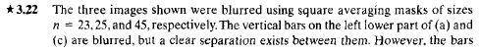
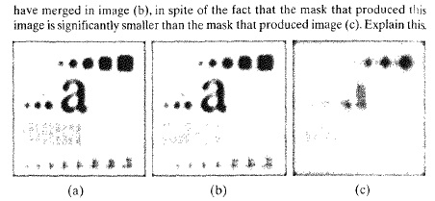
#Spatial Filtering (Neighborhood Processing)
Linear Spatial Filtering
Exercise 3 [1]: (due in next class)
Hint: Vertical bars are 5 pixels wide and their separation is 20 pixels

Slide 88
Use of Second Derivatives for Enhancement
O O O
f(x-1) f(x) f(x+1)
O O
f(x)- f(x-1) f(x+1) - f(x) 1st derivative
O
[ f(x+1) - f(x)]-[f(x)- f(x-1)] 2nd derivative
= f(x+1)+ f(x-1)- 2f(x)
Notes:
1st derivative approximation formula is achieved by forward divided difference
2nd derivative formula is achieved by applying backward divided difference on 1st derivative approx. formula
http://numericalmethods.eng.usf.edu/

Slide 89
Linear Spatial Filters
Sharpening Spatial Filters
Sharpening filters are based on computing spatial derivatives of an image.
The first-order derivative of a one-dimensional function f(x) is
The second-order derivative of a one-dimensional function f(x) is

Slide 90
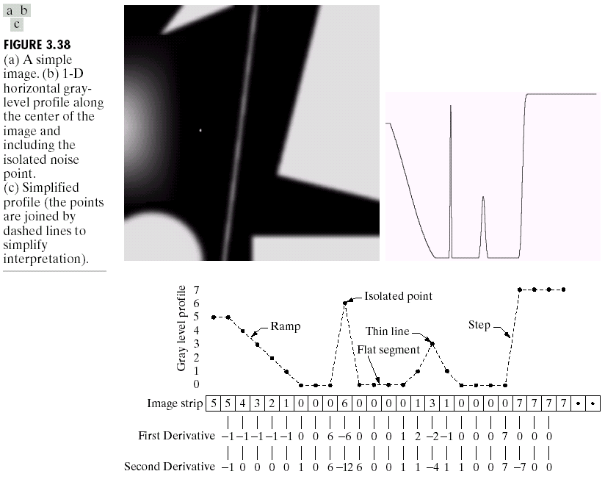
Sharpening Spatial Filters
An Example

Slide 91
Linear Spatial Filters
Sharpening Spatial Filters
Summary: [2, pp. 149]
First-order derivatives:
Generally produce thicker edges in an image
Generally have a stronger response to a gray-level step

Slide 92
Linear Spatial Filters
Sharpening Spatial Filters
Summary: [2, pp. 149]
Second-order derivatives:
Stronger response to fine detail, such as thin lines and isolated points
Produce a double response at step changes in gray-level
More stronger response to a point than a line, and to a line than a step

Slide 93
Linear Spatial Filters
Sharpening Spatial Filters
Conclusion:
The principal use of first derivatives in image processing is edge detection.
In most applications, the second derivatives are better suited than the first derivatives for image enhancement.

Slide 94
Use of Second Derivatives for Enhancement
The Laplacian
Development of the Laplacian method
The two dimensional Laplacian operator for continuous functions:
The Laplacian is a linear operator.

Slide 95
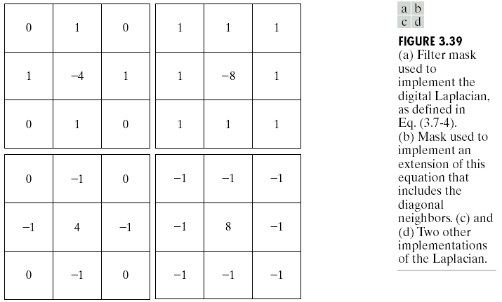
Use of Second Derivatives for Enhancement
The Laplacian

Slide 96
Use of Second Derivatives for Enhancement
(The Laplacian)
Because the Laplacian is a derivative operator, its use highlights gray-level discontinues.
To sharpen an image, the Laplacian is based on the equation:
Function: fspecial(‘laplacian’, alpha)
implements a more general Laplacian mask:

Slide 97
Use of Second Derivatives for Enhancement
(The Laplacian)
Example: 1/2
>> f = imread('moon.tif'); % Image of the north pole of the moon - Courtesy of NASA
>> w4 = fspecial('laplacian', 0);
>> d = im2double(f);
>> dw4 = imfilter(d, w4, 'replicate');
>> g4 = d-dw4;
>> subplot(1,3,1), imshow(f), subplot(1,3,2),imshow(dw4), subplot(1,3,3), imshow(g4)
Enhancement using the Laplacian filter with -4 in the center
Notes:
Hint: [2, pp. 153]

Slide 98
Use of Second Derivatives for Enhancement
(The Laplacian)
Example: 2/2
>> f = imread('moon.tif');
>> w8 = [1 1 1; 1 -8 1; 1 1 1];
>> d = im2double(f);
>> dw8 = imfilter(d, w8, 'replicate');
>> g8 = d-dw8;
>> subplot(1,3,1), imshow(f), subplot(1,3,2),imshow(dw8), subplot(1,3,3), imshow(g8)
Enhancement using the Laplacian filter with -8 in the center
Notes:
Hint: [2, pp. 153]

Slide 99
# Use of Second Derivatives for Enhancement
(The Laplacian)
Exercise:
Find suitable Laplacian filters to simplify the process of image enhancement without subtraction or addition of original image. for
(a) –ve center
(b) +ve center
and for
4 at center
8 at center
Notes:
Hint: [2, pp. 153]

Slide 100
@ #
Remaining part is for DIP Graduate students only

Slide 101
Nonlinear Spatial Filtering
Nonlinear Spatial Filtering
Matlab functions are nlfilter and colfilt
colfilt:
Given an input image of size MN, and a neighborhood of size mn
Output image would be of size mnMN
Syntax:
g = colfilt(f, [m n], ‘sliding’, @fun, parameters)

Slide 102
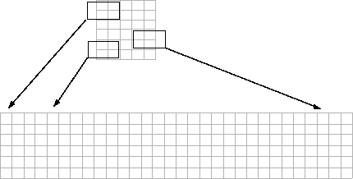
Nonlinear Spatial Filtering
colfilt: Creates a Temporary Matrix say A for Sliding Neighborhood. It can perform similar operations to blkproc and nlfilter, but often executes much faster.
In this figure, a 6-by-5 image matrix is processed in 2-by-3 neighborhoods. colfilt creates one column for each pixel in the image, so there are a total of 30 columns in the temporary matrix. Each pixel’s column contains the value of the pixels in its neighborhood, so there are six rows. colfilt zero-pads the input image as necessary. For example, the neighborhood of the upper left pixel in the figure has two zero-valued neighbors, due to zero padding.
Notes:
http://radio.feld.cvut.cz/matlab/toolbox/images/block9.html

Slide 103
Nonlinear Spatial Filtering
Matrix A
>> f=[1 2; 3 4]
f =
1 2
3 4
>> g = colfilt(f,[3 3],'sliding',@mean)
% 'sliding' or [mblock nblock]
g =
1.1111 1.1111
1.1111 1.1111
>> g = colfilt(f,[3 3],'sliding',@gmean)
g =
0 0
0 0
Why?
0 | 0 | 0 | 1
0 | 0 | 1 | 2
0 | 0 | 2 | 0
0 | 1 | 0 | 3
1 | 2 | 3 | 4
2 | 0 | 4 | 0
0 | 3 | 0 | 0
3 | 4 | 0 | 0
4 | 0 | 0 | 0
0 | 0 | 0 | 0
0 | 1 | 2 | 0
0 | 3 | 4 | 0
0 | 0 | 0 | 0
% gmean.m
function v = gmean(A)
mn = size(A,1); % The length of the columns of A is always mn
v = prod(A,1).^(1/mn);
Notes:
D:\Flash-8GB\Teaching-Current\Digital Image Processing-2012-Fall\Examples\Habib

Slide 104
Nonlinear Spatial Filtering
>> f=[1 2; 3 4]
f =
1 2
3 4
>> fp = padarray(f,[2 2], 'replicate')
fp =
1 1 1 2 2 2
1 1 1 2 2 2
1 1 1 2 2 2
3 3 3 4 4 4
3 3 3 4 4 4
3 3 3 4 4 4
>> g = colfilt(fp,[3 3],'sliding', @mean)
g =
0.4444 0.6667 0.8889 1.1111 1.3333 0.8889
0.6667 1.0000 1.3333 1.6667 2.0000 1.3333
1.1111 1.6667 2.0000 2.3333 2.6667 1.7778
1.5556 2.3333 2.6667 3.0000 3.3333 2.2222
2.0000 3.0000 3.3333 3.6667 4.0000 2.6667
1.3333 2.0000 2.2222 2.4444 2.6667 1.7778
>> g = colfilt(fp,[3 3],'sliding', @gmean)
g =
0 0 0 0 0 0
0 1.0000 1.2599 1.5874 2.0000 0
0 1.4422 1.7371 2.0922 2.5198 0
0 2.0801 2.3949 2.7574 3.1748 0
0 3.0000 3.3019 3.6342 4.0000 0
0 0 0 0 0 0

Slide 105
Nonlinear Spatial Filtering
Example:
f = imread(‘rose.tif');
imshow(f)
g = uint8(colfilt(f,[5 5],'sliding', @mean)); figure, imshow(g)
Exercise: (due in next class)
Modify above example with
geometric mean
max

Slide 106
Nonlinear Spatial Filters
Order Statistics or Ranked Filters
Syntax: g = ordfilt2(f, order, domain)
domain is mn matrix of 1s and 0s.
Example: >> g = ordfilt2(f, 1, ones(m, n))
implements a min filter of size mn.
What about?: >> g = ordfilt2(f, m*n, ones(m, n))
Median filter: >> g = ordfilt2(f, median(1:m*n), ones(m, n))
What about?: >> g = ordfilt2(f, 5, ones(3, 3))
Median filtering is a useful tool for reducing salt-and-pepper noise.

Slide 107
Nonlinear Spatial Filters
Order Statistics or Ranked Filters
>> f = imread('cktboard.tif');
>> fn = imnoise(f, 'salt & pepper', 0.2);
>> gm = medfilt2(fn);
>> gms = medfilt2(fn, 'symmetric');
>> imshow(f), figure, imshow(fn)
>> figure, imshow(gm), figure, imshow(gms)
(a)
(b)
(c)
(d)

Slide 108
References
Gonzalez R. C., Woods R. E., Digital Image Processing, Pearson Education, Second Edition, 2006.
Gonzalez R. C., Woods R. E., Eddins S. L., Digital Image Processing Using Matlab, Pearson Education, 2006.
Institute of Signal Processing, Tampere University of Technology, Finland, http://www.cs.tut.fi/~karaoglu/
MatLab Code download: https://beagle.whoi.edu/redmine/projects/ifcb-web/repository/revisions/2/entry/trunk/dipum_toolbox_registered/dipum_1.1.3/

Slide 110
M-Functions for Intensity Transformations
(Self Reading)
Input and Output Arguments to Functions
Function | Description
nargin | returns the number of arguments input into the function
nargout | returns the number of arguments output from a function
narginchk( low, high) | This checks if the input arguments (nargin) are between low and high (inclusive). If they aren't, then execution stops and an error message (with the string returned from nargchk) is printed A sample usage of nargchk inside a function is: error (nargchk (2, 3, nargin)); Returns Examples "Not enough input parameters" if number is less than low and returns "Too many input parameters" if number is greater than high.
varargin | accepts a variable number of arguments
varargout | returns a variable number of arguments

Slide 111
#M-Functions for Intensity Transformations
Exercise: itrans.m
is capable of doing all of the intensity transformations mentioned above.
function g = intrans(f, varargin)
Transformation | Intensity Transformation Function | Corresponding intrans Call
photographic negative | neg=imcomplement(I); | neg=intrans(I,'neg');
logarithmic | I2=im2double(I); log=5*log(1+I2); | log=intrans(I,'log',5);
gamma | gamma=imadjust(I,[],[],0.4); | gamma=intrans(I,'gamma',0.4);
contrast-stretching | I2=im2double(I); contrast=1./(1+(0.2./(I2+eps)).^5); | contrast=intrans(I,'stretch',0.2,5);

Slide 112
#An M-Function for Intensity Scaling
Exercise ([2, page 89]):
Write an M-Function to scale the image to the full, maximum range, [0, 255] or [0, 65535]. In addition, the function should map the output levels to a specified range.
Syntax: g = gscale(f, method, low, high)
Valid methods: full8 or full16

